Slide 1
DATA SCIENCE
11 WEEK PART TIME COURSE
Week 1 - Data Science & Git
Wednesday 22nd March

Slide 2
AGENDA
What are the steps in a Data Science project?
What is Python and why is it Popular with Data Scientists?
Bit more Git
Git Lab
Discussion
Course Projects
Homework

Slide 3
WHAT ARE THE STEPS IN A
DATA SCIENCE PROJECT?
DATA SCIENCE PART TIME COURSE

Slide 4
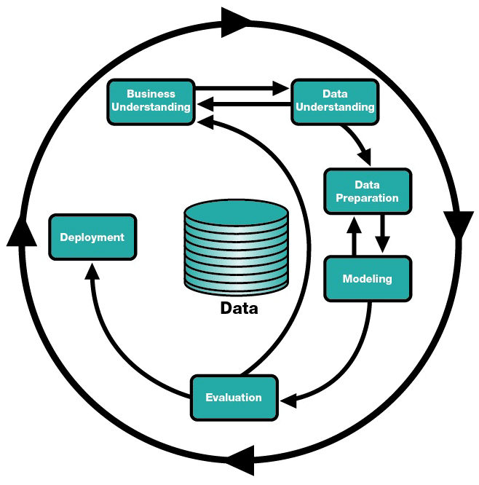

Slide 5
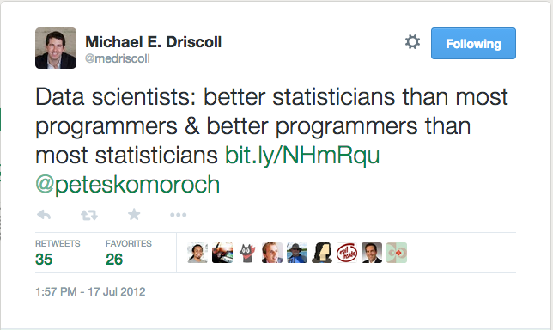
PYTHON AND DATA SCIENCE
What is Data Science?

Slide 6








PROGRAMMING FOR DATA SCIENCE
“Data analysis projects today rely on databases, computer and network hardware, and computer and network software. A collection of models and methods for data analysis will be used only if the collection is implemented in a computing environment that makes the models and methods sufficiently efficient to use”

Slide 7

WHAT IS PYTHON
Created by Guido Van Rossem in 1991 and emphasizes productivity and code readability
Version 3 (but 2.7 is still very popular)
“Python is an interpreted, object-oriented, high-level programming language with dynamic semantics”

Slide 8


WHY CHOOSE PYTHON?
Batteries Included: Large collection of built in libraries e.g. SciKit, Pandas, Theano, etc
Simple and clean syntax
General purpose language: lots of people outside of data science will be able to work with it

Slide 9
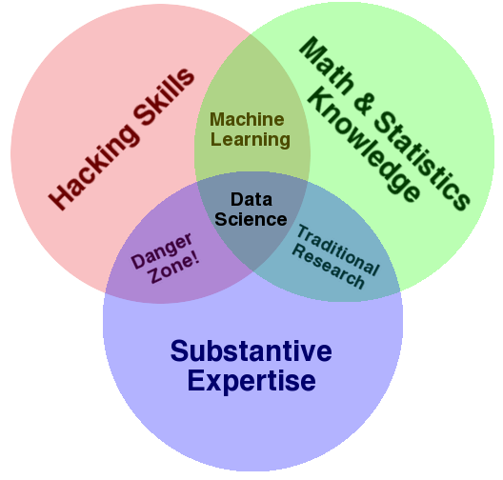


PYTHON & R

Slide 10
USING DATA SCIENCE PACKAGES
DATA SCIENCE PART TIME COURSE

Slide 11
WHAT ARE PACKAGES?
Packages are libraries of code written to solve a particular set of problems
In Python there are many related to data science including Pandas, SciKit Learn, Numpy
These are installed and managed with PIP (Pip Installs Packages)
pip install some-package-name

Slide 12
WHAT PACKAGES DO YOU NEED?
pandas: manipulate data
SciPy / NumPy: scientific computing and numerical calculations
scikit-learn: use machine learning methods
matplotlib: visualise data
statsmodels: perform statistical tests
Beautiful Soup: read in XML and HTML data
iPython: interactive programming

Slide 13

A BIT MORE GIT!
DATA SCIENCE PART TIME COURSE

Slide 14
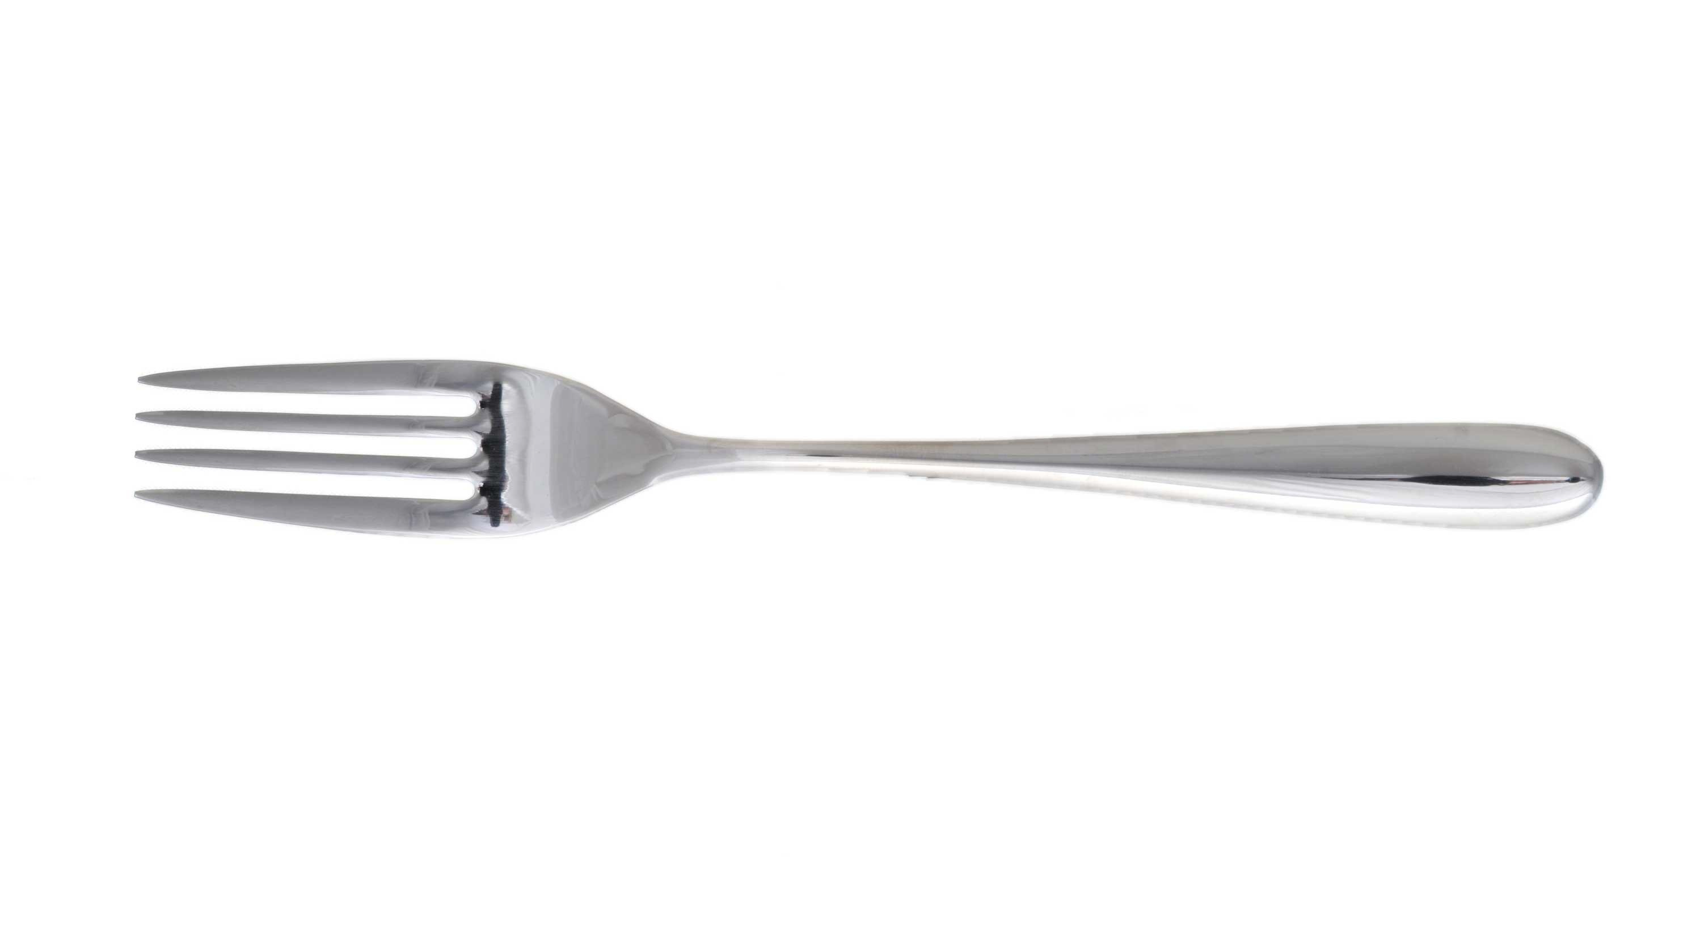
HOW DO WE ACTUALLY COLLABORATE WITH GIT?
Forking, making a copy of someone else’s repository so you can work on it

Slide 15
HOW DO WE ACTUALLY COLLABORATE WITH GIT?
Course Repo
github.com/coolstudent/SYD_DAT_3
Course Repo
github.com/ihansel/SYD_DAT_3
1. Fork
6. Pull Request
2. Clone
5. Push
CoolStudent Laptop
3. Update a file
4. Commit

Slide 16
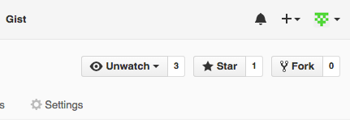
HOW DO WE ACTUALLY COLLABORATE WITH GIT?
Course Repo
github.com/coolstudent/SYD_DAT_3
1. Fork
Course Repo
github.com/ihansel/SYD_DAT_3
6. Pull Request
2. Clone
5. Push
CoolStudent Laptop
Forking, making a copy of someone else’s repository so you can work on it
3. Update a file
4. Commit

Slide 17
HOW DO WE ACTUALLY COLLABORATE WITH GIT?
Course Repo
github.com/coolstudent/SYD_DAT_3
Course Repo
github.com/ihansel/SYD_DAT_3
1. Fork
6. Pull Request
2. Clone
5. Push
CoolStudent Laptop
Cloning is copying the repo to your local machine (like Monday’s class)
3. Update a file
4. Commit

Slide 18
HOW DO WE ACTUALLY COLLABORATE WITH GIT?
Course Repo
github.com/coolstudent/SYD_DAT_3
Course Repo
github.com/ihansel/SYD_DAT_3
1. Fork
6. Pull Request
2. Clone
5. Push
CoolStudent Laptop
Update files and commit any changes you make (still only on your local machine)
3. Update a file
4. Commit

Slide 19
HOW DO WE ACTUALLY COLLABORATE WITH GIT?
Course Repo
github.com/coolstudent/SYD_DAT_3
Course Repo
github.com/ihansel/SYD_DAT_3
1. Fork
6. Pull Request
2. Clone
5. Push
CoolStudent Laptop
Push the changes from your local machine to your github account
3. Update a file
4. Commit

Slide 20
HOW DO WE ACTUALLY COLLABORATE WITH GIT?
Course Repo
github.com/coolstudent/SYD_DAT_3
Course Repo
github.com/ihansel/SYD_DAT_3
1. Fork
6. Pull Request
2. Clone
5. Push
CoolStudent Laptop
Then submit those changes as a pull request so I can see them.
3. Update a file
4. Commit

Slide 21

GIT LAB
DATA SCIENCE PART TIME COURSE

Slide 22
DISCUSSION TIME
DATA SCIENCE - Week 1 Day 2

Slide 23
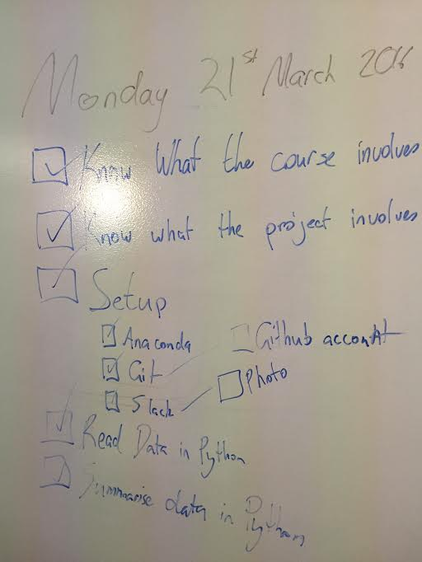

Slide 24
DISCUSSION TIME
Prework
Readings
Metacademy Learning Plan
Data Science Handbook
An Introduction to Statistical Learning
DATA SCIENCE - Week 1 Day 2

Slide 25
DISCUSSION TIME
Homework
Due next Friday
I will review within 7 days
Counts to letter of completion
(Will be easy)
DATA SCIENCE - Week 1 Day 2

Slide 26
